Slide 1
Frontline Excellence in Ambulatory Chronic Disease Management Module 1: Heart Failure and Diabetes
CME Series
November 11, 2020
6:00pm-7:30pm

Slide 2
Agenda
Welcome and Introduction
Heart Failure Types, Office and Medication Management, Referrals and Multidisciplinary Teamwork
Heart Failure Rapid Follow Up Clinic Overview
Q&A Session
Diabetes Type II: Medication Management and Newer Medication Options, Including Cardiac Benefits
Q&A Session

Slide 3
Poll Question: What best describes your role?
Primary Care Physician
Specialist Physician
Advanced Practice Provider (NP, PA, APN, Clinical Pharmacist)
Allied Health Professionals (including CDEs)
Non-Clinical Staff

Slide 4
Heart Failure Types, Office and Medication Management, Referrals and Multidisciplinary Teamwork
Donna Mancini, MD
Professor of Medicine
Medical Director of Heart Failure and Transplant Mount Sinai Hospital and Mount Sinai Health System

Slide 5
No relevant financial disclosures or conflicts of interest

Slide 6
Stages of Heart Failure
Stage | Description | Treatment
A At risk for HF | HT, diabetes, CAD, cardiotoxins, family hx | Rx HT, lipid disorders, smoking cessation, exercise Limit ETOH ACE in appropriate pts
B Structural Heart Disease; no symptoms | Prior MI, LVSD, valvular disease | All measures in stage A ACE and β blockers in appropriate pts
C Symptoms | Structural disease with SOB, fatigue, decreased exercise capacity | Restrict Na Diuretics, digoxin, ACE and β blockers
D Refractory | Symptoms at rest despite maximum medical therapy | All measures in stages A, B, C Mechanical devices, transplant, continuous inotropic infusions, hospice care
6 million patients
200,000 patients

Slide 7
NYHA Classification
 | Class | Patient Symptoms
 | Mild | No limitation of physical activity No undue fatigue, palpitation or dyspnea
 | Mild | Slight limitation of physical activity Comfortable at rest Less than ordinary activity results in fatigue, palpitation, or dyspnea
 | Moderate | Marked limitation of physical activity Comfortable at rest Less than ordinary activity results in fatigue, palpitation, or dyspnea
 | Severe | Unable to carry out any physical activity without discomfort Symptoms of cardiac insufficiency at rest Physical activity causes increased discomfort
I
II
III
IV
Notes:
The New York Heart Association (NYHA) classification is primarily used to describe the functional limitations of patients. This system relates symptoms to everyday activities and the patient’s quality of life.
This classification allows patients to move from one class to another based on symptoms. A patient with class IV heart failure could move to class III with diuretic therapy. It does not address the evolution and progressive nature of heart failure.
Criteria Committee of the New York Heart Association, Diseases of the Heart and Blood Vessels:
Nomenclature and Criteria for Diagnosis. 6th ed. Boston, MA: Little Brown, 1964.

Slide 8
Types of Heart Failure
 | HFrEF | HFpEF
Pathophysiology | Impaired Contraction | Impaired filling
Demographics | All ages | > 60 years
1° Cause | Coronary Artery Disease | Hypertension
Notes:
Heart Failure can be divided into two types:
Systolic Heart Failure
Diastolic Heart Failure
Systolic heart failure is characterized by:
An enlarged cardiac chamber with
An impaired ability to pump because of
Preexisting heart attacks caused by blockages of the coronary arteries
This disorder affects patients of all ages.
Diastolic heart failure on the contrary is characterized by:
A thick walled heart muscle with small chambers that result
In a stiffening of the heart muscle with an
Impaired ability to fill with blood but a normal pumping capacity.
DHF affects predominately elderly subjects and hypertension is main underlying cause.

Slide 9
Clinical Manifestations
Symptoms
Reduced exercise tolerance
Shortness of breath
Congestion
Fluid retention
Difficulty in sleeping
Weight loss
Variable | Sensitivity | Specificity
Hx of HF | 62 | 94
Dyspnea | 56 | 53
Orthopnea | 47 | 88
Rales | 56 | 80
S3 | 20 | 99
JVD | 39 | 94
Edema | 67 | 68

Slide 10
HFpEF
Patients have symptoms and signs of HF, a normal or near normal left ventricular ejection fraction (LVEF ≥50 percent), and evidence of cardiac dysfunction as a cause of symptoms (eg, abnormal left ventricular filling and elevated filling pressures).
Approximately ~50% of patients with heart failure are HFpEF, and proportion is increasing.
Dominate form of heart failure in the elderly.
No therapies with proven mortality benefit, unlike HFrEF.

Slide 11
Treatment of HFpEF
Treat volume overload with diuretics
Direct treatment at co-morbidities
HT- diuretics, MRA, ACE/ARNI
Diabetes -SGLT2I
CAD
Afib
Obesity
CRF-ACE/ARB
OSA

Slide 12
Treatment of Heart Failure reduced EF
Treatment of Heart Failure Reduced Ejection Fraction
Diuretics
Vasodilators
Inotropes
Augment Contractility
Reduce fluid volume
Decrease Preload and Afterload

Slide 13
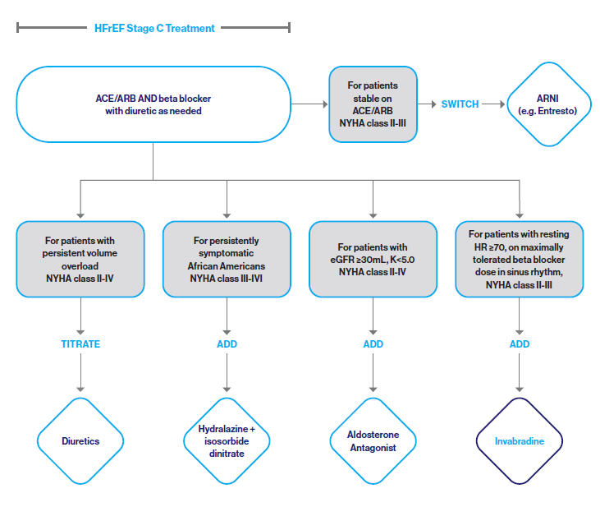
Heart Failure Pathway Writing Committee. J Am Coll Cardiol 2018;71(2):201-230.
Notes:
Speaker 1

Slide 14
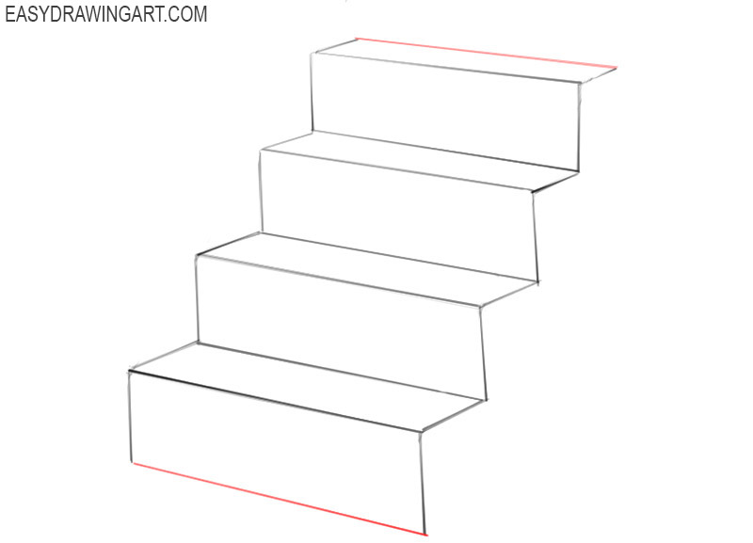
Step Therapy for HFrEF
SGLT2
Newest step
Digoxin
Afib
women
MRA
Class II-IV
Ivabradine NSR w rate > 70 bpm on maximal BB
Beta Blocker
Class I-IV
CRT LBBB w QRS duration >0.14 msec
IVCD w QRS > 015
100% paced rhythm
ICD 40 days post MI w LVEF <35%
6 mo post new onset CHF on meds
Hydralazine/
Isordil
African Americans
Renal insufficency
ACE/ARB/ARNI
Class I-IV
Diuretics

Slide 15
Starting and Maximal doses of Diuretics
 | Initial Daily Dose
Diuretics-Thiazides
Chlorthalidne | 12.5-25 mg once
Hydrochlorothiazide | 25 mg once or twice
Metolazone | 2.5 mg once
Diuretics-Loop
Bumetanide | 0.5-1.0 mg once or twice
Furosemide | 20-40 mg once or twice
Torsemide | 10-20 mg once
2 gm Sodium Diet
Major deficiency on referral is
Often Inadequate diuretic doses
Identify the renal threshold
Dose
One large dose is better than
Multiple low doses
Eliminate nephrotoxic drugs-
NSAID
No fast foods
Canned soups
Coldcuts
No added salt

Slide 16
Drugs That Reduce Mortality in Heart Failure With Reduced Ejection Fraction
Angiotensin
receptor
blocker
Mineralocorticoid
receptor
antagonist
ACE
inhibitor
Beta
blocker
0%
10%
% Decrease in Mortality
20%
Drugs that inhibit the renin-angiotensin system have modest effects on survival
30%
40%
Based on results of SOLVD-Treatment, Consensus, CHARM-Alternative,
COPERNICUS, MERIT-HF, CIBIS II, RALES and EMPHASIS-HF

Slide 17
Sacubitril/Valsartan (Entresto)
Vardeney O, et al. JACC-HF 2014

Slide 18
PARADIGM-HF: Summary of Findings
In heart failure with reduced ejection fraction, when
compared with recommended doses of enalapril:
Entresto was more effective than enalapril in . . .
Reducing the risk of CV death and HF hospitalization
Reducing the risk of CV death by incremental 20%
Reducing the risk of HF hospitalization by incremental 21%
Reducing all-cause mortality by incremental 16%
Incrementally improving symptoms and physical limitations
Entresto was better tolerated than enalapril . . .
Less likely to cause cough, hyperkalemia or renal impairment
Less likely to be discontinued due to an adverse event
More hypotension, but no increase in discontinuations
Not more likely to cause serious angioedema

Slide 19
Conversion from ACE to ARNI
Exclude patients with a history of angioedema
Maintain off ACE for 36 hrs before beginning ARNI
GFR < 30 ml/min-starting dose Entresto 24/26 mg po BID
High dose ACE/ARB (>10 mg enalopril or 10 mg lisinopril, > valsartan 160 mg daily) start Entresto at 49/51 mg BID dose

Slide 20
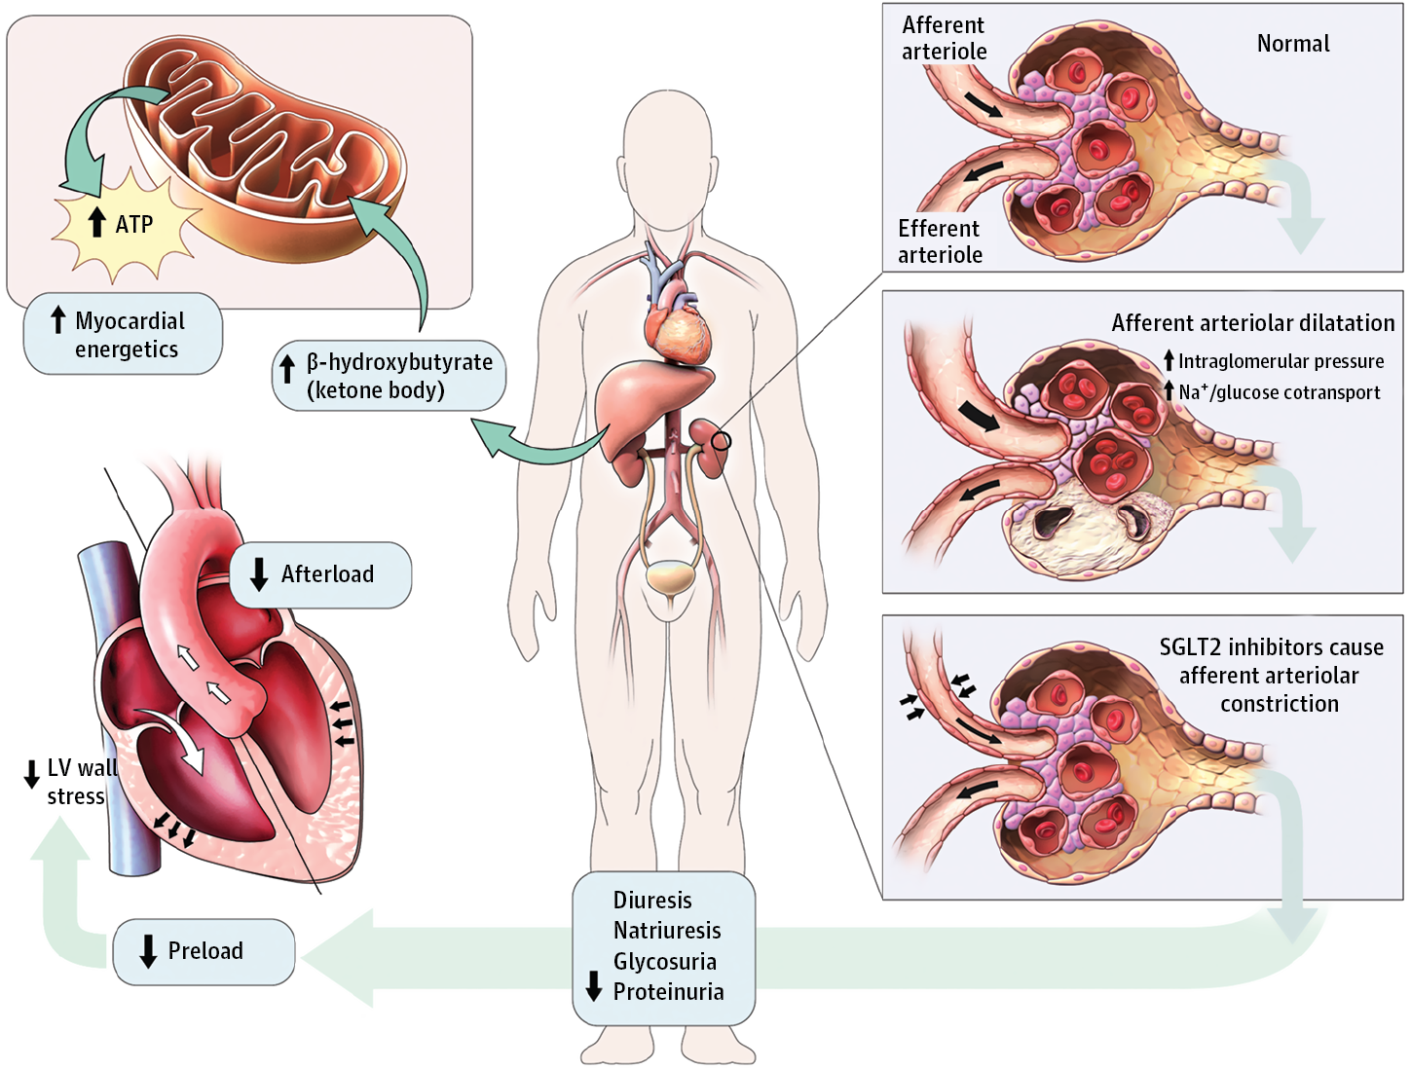
SGLT2 Inhibition
JAMA Cardiol. 2017;2(9):939-940.
Notes:
Proposed Mechanism of Cardiorenal Protection With Sodium-Dependent Glucose Cotransporter 2 (SGLT2) InhibitorsAt the level of the kidney, SGLT2 inhibition promotes glycosuria and natriuresis. It also promotes afferent arterioral constriction resulting in a decrease in intraglomerular pressure. A reduction in preload and resultant left ventricular (LV) wall stress improves overall LV filling conditions. Additionally, metabolic effects of SGLT2 inhibition to improve myocardial energetics and reduce afterload have also been proposed as cardioprotective mechanisms. ATP indicates adenosine triphosphate. This figure was specifically commissioned for this article and has not been reproduced in any form in any media format. Figure created by M. Gail Rudakevich, BSc, MScBMC.

Slide 21
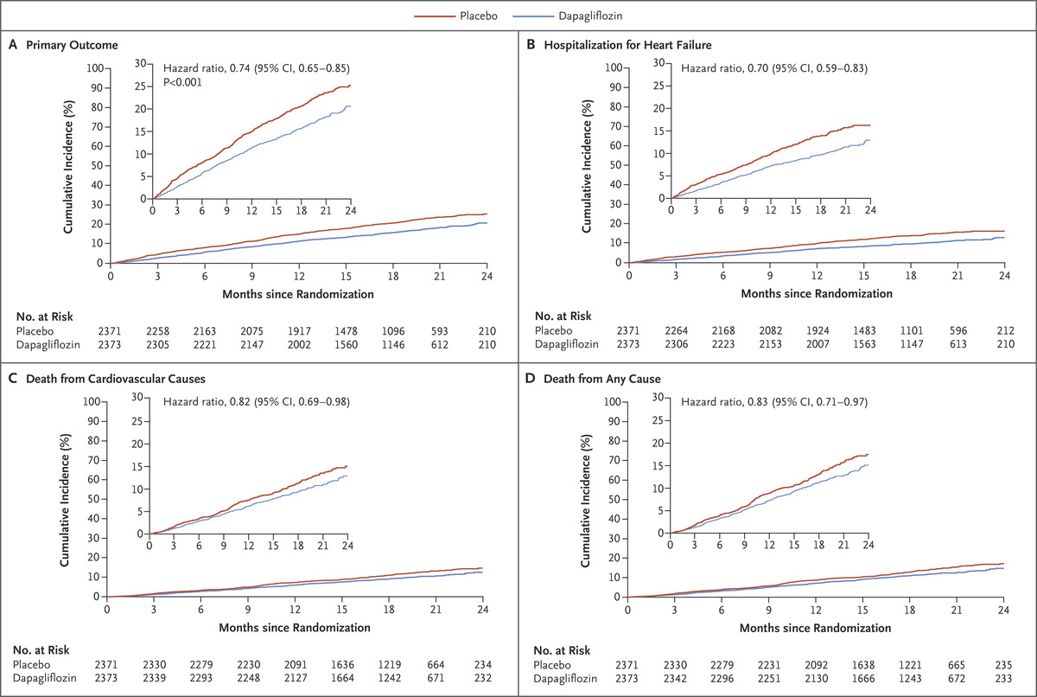
JJ McMurray et al. N Engl J Med 2019;381:1995-2008.
Cardiovascular Outcomes
4744 patients w Class II-IV CHF
Randomized 10 mg dapagliflozin vs
placebo
Dapa or Empa at
10 mg daily
GFR>30 ml/min
Do not use if
1. Prior DKA or
risk for DKA
2. Recurrent UTIs
Notes:
Figure 2. Cardiovascular Outcomes. The primary outcome was a composite of death from cardiovascular causes, hospitalization for heart failure, or an urgent visit resulting in intravenous therapy for heart failure (Panel A). The cumulative incidences of the primary outcome, hospitalization for heart failure (Panel B), death from cardiovascular causes (Panel C), and death from any cause (Panel D) were estimated with the use of the Kaplan–Meier method; hazard ratios and 95% confidence intervals were estimated with the use of Cox regression models, stratified according to diabetes status, with a history of hospitalization for heart failure and treatment-group assignment as explanatory variables. Included in these analyses are all the patients who had undergone randomization. The graphs are truncated at 24 months (the point at which less than 10% of patients remained at risk). The inset in each panel shows the same data on an enlarged y axis.

Slide 22
Titration of Medical Therapy for HFrEF: CHAMP registry
3500 HF patients in out
Patient practices
Up titration of GDMT is
Frequently inadequate
Red is subtherapeutic dose
Journal of American College of Cardiology (JACC), Volume: 73, Issue: 19, Pages: 2365-2383,

Slide 23
Hypertension Treating Hypertension in Stage C HFrEF
COR | LOE | Recommendations | Comment/Rationale
I | C-EO | Patients with HFrEF and hypertension should be prescribed GDMT titrated to attain systolic blood pressure less than 130 mm Hg | NEW: Recommendation has been adapted from recent clinical trial data but not specifically tested per se in a randomized trial of patients with HF

Slide 24
Clinical Case
A 68-year-old African American woman with hypertension, CKD-3 and T2DM presents for ongoing heart failure care
She has a non-ischemic cardiomyopathy, LVEF 30% with Stage C HF
She reports one-block exercise tolerance, no orthopnea or LE swelling
Last hospitalized 3 months ago for 4 days
Her medications are losartan 25 mg, carvedilol 3.125 mg BID, furosemide 40 mg, metformin 1000 mg bid and vitamin D
On exam, BP 130/80, pulse 80 and regular, BMI 28. No JVD, clear lungs, regular rhythm, normal S1S2 no S3. Grade II/VI HSM. No hepatomegaly or LE edema.
Labs: Na 138, K 4.8, BUN/Cr 28/1.4. NT-proBNP 1200 pg/mL
EKG: NSR, LAE, LBBB, QRSd 152 msec
CXR: cardiomegaly, clear lungs, no effusion
What is the next most appropriate step in her management?
Stop losartan and start sacubitril/valsartan 24/26 mg bid
Start ISDN/hydralazine
Start spironolactone 25 mg
Add dapagliflozin 10 mg
Upgrade her ICD to a CRT-D

Slide 25
When to Refer to MS HF Program/Community HF Specialist
Persistent NYHA Class III-IV
1 or more ER visits or hospitalizations for HF
Clinical deterioration despite treatment
Inability to tolerate GDMT
Systolic BP < 90 mm Hg or symptomatic hypotension
BUN > 43 or Cr > 1.8
Onset of afib, ventricular arrhythmias or ICD shocks

Slide 26
Multidisciplinary Considerations for Patients with HF
Care Management
Email mshpcmreferral@mountsinai.org, call 212-241-7228, or use the MSHP Care Management Referral in Epic (order #391414)
Prompt and efficient processing of your referral
Communication about assignment through Epic In-Basket
Follow up from clinical staff within 1 week of assignment
Behavioral Health
Screen patients annually for depression using the PHQ-2/PHQ-9 and refer to psychiatric services
Palliative Care
NYHA class III/IV symptoms with frequent readmissions
Anxiety/depression adversely affecting quality of life or ability to manage illness
Assistance with decision making regarding advanced therapies
Martha Stewart Center for Living, 1440 Madison Avenue, 212-241-1446
Martha Stewart Center for Living Downtown, Union Square, 212-844-1712

Slide 27
Conclusions
Heart Failure is a team sport: Optimize multidisciplinary care
Follow the guidelines and up-titrate meds to effective doses used in clinical trials
African-American patients experience further benefit from the use of HYD/ISDN therapy
Major advances in the treatment of Heart failure centering on neurohormonal inhibition (i.e. subcutril/valsartan)
Management of co-morbidities especially in patients w HFpEF
Hospitalizations and Mortality remain high
Many new devices CRT, Mitral Clip, LVADs

Slide 28
Heart Failure Rapid Follow Up Clinic Overview
Beth Oliver, DNP, RN
Chief Nurse Executive
Senior Vice President, Cardiac Services
Mount Sinai Health System
November 11, 2020

Slide 29
No relevant financial disclosures or conflicts of interest

Slide 30
Rapid Follow Up and Transition of Care
*AHA, Target HF, recommends all patients admitted with HF have follow up clinic visit within 7 days of hospital discharge and that it is documented
This is the only discharge procedure which reduces readmissions
Considered an extension of the hospitalization
Goal is to reduce and eliminate burden across the spectrum
Comprehensive follow up for transition to next step
Patient receives focused/ tailored HF patient education at the bedside
Sinai swag (Scale, pitcher, pill box, and Managing your Heart Health patient guide)
Appointment made for RFU along with patient and care partners/family
Physical exam including ReDS (if available) and labs, patient education, medication optimization, appropriate referrals - (PCP, specialist, cardiology, VNS), follow up communication with team and patient

Slide 31
MSHS Rapid Follow Up Structure
Clinic started in 2014 at MSH, NP run with MD Support
Program operationalized across system (MSSL, MSQ, MSBI, MSSN – MSW coming soon)
Significant positive impact on readmission rate
Hospital | RFU Schedule | Avg # of Pts Per Session | Contact | Contact Info
MSH | Wed | 10-20 patients | Jennifer Ullman, NP | Jennifer.ullman@mountsinai.org Cell: 646-584-8947 To schedule 212 241-7300 Opt 1
MSQ | Mon & Wed | 8 patients | Tiffany Vargas, NP | Tiffany.vargas@mountsinai.org Cell 347-502-3951 To schedule 718-808-7777
MSM | Mon-Fri | 2 per 7 scheduled half day sessions with one walk in session | Cathy Varley, NP | cathleen.varley@mountsinai.org | Cell: 646 832 5088 To schedule: Mirella.Galarza@mountsinai.org 212-636-1432
MSBI | Wed (9am-1pm) | 5-6 patients | Jayitha Janardhanan, NP | To schedule RFU, contact 212-844-8830 or EPIC secure chat to MSBI CHF team (inpatient discharges). Cell: 646-400-4889 | Jayitha.Janardhanan@mountsinai.org
MSSN* | Wed | 4-5 patients | Eileen Harris, RN | Eileen.harris@snch.org | 516-632-3572
*MSSN runs Cardiac Wellness Program where interdisciplinary team sees patients (RN, Pharmacist and Dietician) – modified RFU
Notes:
MSW coming soon

Slide 32
Lessons Learned and Take Aways
Despite our success, additional work to do:
Continued and improved communication with home care, social work and SARs
Improve referrals from primary care providers (gatekeepers)
Continuing to educate teams about benefits of RFU
Ensure transition to community paramedicine/VNSNY
Close communication loop with primary care, cardiology and HF Team
Patient Education is at the center of transition of care
Communication is paramount and lack of leads to poor patient care, outcomes and satisfaction
Help to make sure patient has right medications and understands discharge plan and self care-before they are discharged
Ensure patient has a RFU appointment- before they are discharged
Rapid Follow Up is important piece in transition of care for HF patients

Slide 33
Q & A

Slide 34
Medication Management in Diabetes Type II and Newer Medication Options, Including Cardiac Benefits
David W. Lam, MD
Assistant Professor of Medicine
Department of Medicine, Endocrinology, Diabetes and Bone Disease
Icahn School of Medicine at Mount Sinai

Slide 35
No relevant financial disclosures or conflicts of interest

Slide 36
Overview
Clinical context and the need for a talk on this subject
Discuss the general ambulatory approach to the complex T2D patient
Review current indications and added cardiac benefits of newer T2D agents

Slide 37
Percentage of Adults with Diagnosed Diabetes, New York State, BRFSS 2016
Source: Information for action report 2018-2019. New York State Department of Health

Slide 38
Diabetes Care for the Busy Clinician
Have a management checklist
Establish treatment goals
Utilize evidenced based treatment algorithms
Enlist help

Slide 39
Checklist for DM Management for Front Line Providers
Screening/ Mgmt Target | Benchmark | Frequency | Next Step if uncontrolled/positive finding
HgbA1c Test | <7.0% | Every 6 months if controlled Every 3 months if poorly controlled | Lifestyle modification Escalate dosing of anti-diabetic medications Referral to endocrinologist or pharmacist if HgbA1c >9% CM/BH referral as indicated
Blood Pressure Control | BP <140/90 or <130/80 in select pts with CVD, CAD, or ASCVD risk > 15%* | Annually if normal | Lifestyle modification Home BP monitoring If no CKD, use ACE/ARB, diuretic, or CCB If CKD present: ACE/ARB If resistant hypertension or progressive kidney disease, consider refer to Nephrology or clinical pharmacy program
Lipid Management | LDL is <100 mg/dL. With CV disease, target is <70 mg/dL. | Annually | Lifestyle modification Statin therapy
Cardiovascular Disease | Assess ASCVD Risk (using ASCVD Risk Calculator) and HF Risk (patient 40-79)¹⁰ Antiplatelet Therapy for Primary/Secondary Prevention | Annually | ASA 75-162 mg daily for primary prevention if 50-75 yrs old and >1 additional risk factor ASA 75-162 mg daily for established ASCVD SGLT-2i or GLP-1 RA if multiple risk factors or known ASCVD and/or CKD SGLT-2i if heart failure present
DM Treatment implications

Slide 40
Checklist for DM Management for Front Line Providers
Screening/ Management Target | Benchmark | Frequency | Next Step if uncontrolled/positive finding
Monitoring for Diabetic Kidney Disease (eGFR and UACR) | eGFR >100 UACR <30 mg/g C | Annually (Consider semiannually if EGFR <60 or UACR >30 mg/g of C) | ACE/ARB if eGFR <60 or UACR >30 Consider use of SGLT-2i or GLP-1 RA Intensify anti-diabetic medications to optimize glycemic control Dietary intake of ~0.8 g protein/kg weight per day Consider Nephrology referral
Retinopathy Screening | Absence of retinopathy or macular edema | If retinopathy or macular edema present, annual dilated eye exam or retinal photography | Annual evaluation by ophthalmologist if retinopathy or macular edema present
Foot Exam | No ulcerations or fungal infections, 2+ Pedal pulses, Normal sensory response with monofilament | Annually | Referral to podiatrist for management of any abnormalities Refer for Ankle Branchial Index (ABI) if Peripheral Arterial Disease (PAD) suspected
DM Treatment implications

Slide 41
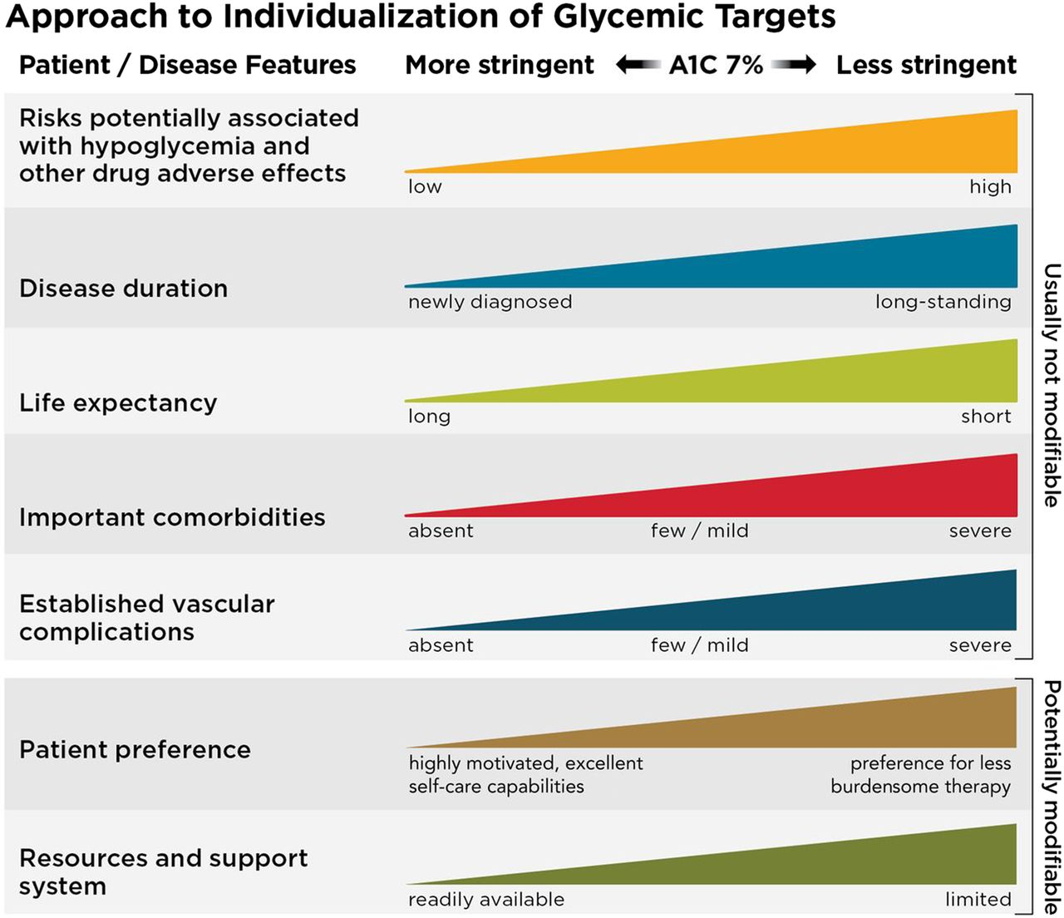
Establish Treatment Goals
HgbA1c <6.5% - More stringent
Low risk of hypoglycemia and adverse effects of intensive treatment
HgbA1c <7% is general target for adults
Corresponds to pre-prandial plasma glucoses between 80-130 mg/dl and postprandial (1-2 hrs.) plasma glucose <180 mg/dl.
HgbA1c <8% - Less stringent
Increased risk of hypoglycemia
Limited life expectancy
Well established complications
Other compelling reasons
Source: American Diabetes Association Standards of Medical Care. Diabetes Care 2020 Jan; 43(Supplement 1): S66-S76
Notes:
This threshold has been proven to reduce development of microvascular complications (retinopathy, neuropathy and CKD) and, though to a lesser extent, macrovascular complication (non-fatal MI, stroke, CV death) in Type 1 and Type 2 DM.

Slide 42
Establish Treatment Goals – Older Adult Considerations
Optimize nutrition
Screen for geriatric syndromes: polypharmacy, cognitive impairment, depression
Dementia – Annual screening after 65
Hypoglycemia – medication class selection
Burden of diabetes medications – frequency, numeracy requirements

Slide 43
49 y/o African American Male with T2D, HbA1C 8.9%, HTN, HLD
Medications:
Metformin 1000 mg BID
ASA 81 mg Qday
Lisinopril 40 mg Qday
Atorvastatin 40 mg QHS
Poll Question: What agent would you recommend to add?
Glipizide
Sitagliptin (Januvia®)
Liraglutide (Victoza®)
Insulin Glargine

Slide 44
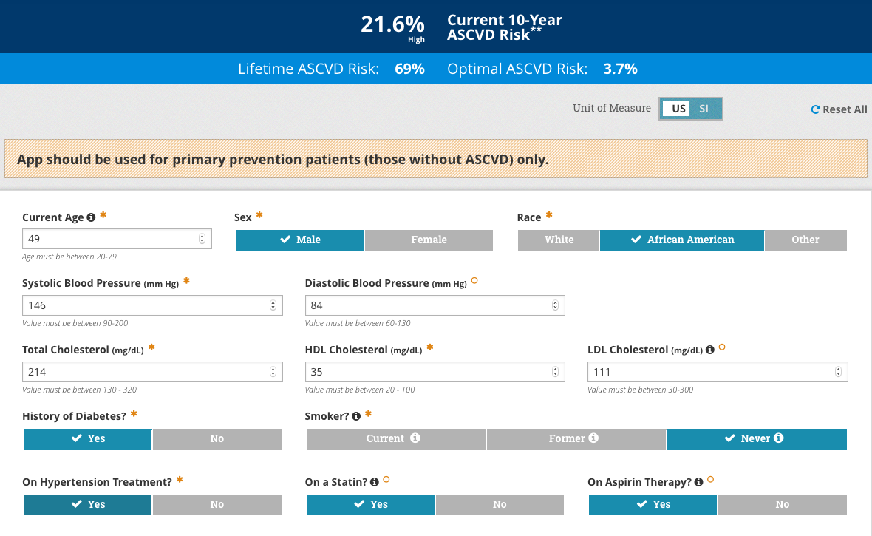

Slide 45
49 y/o AA M With T2D A1C 8.9% with ASCVD 10 year risk 21.6%
FIRST-LINE Therapy is Metformin and comprehensive lifestyle (including weight management and physical activity)
ASCVD Predominates
Established ASCVD
Indicators of high ASCVD risk (age ≥55 years with coronary, carotid or lower extremity artery stenosis >50%, or LVH)
PREFERABLY
GLP-1 RA with proven CVD benefit
OR
SGLT2i with proven CVD benefit if eGFR adequate

Slide 46
GLP-1 Receptor Agonists (GLP1RA)
Native GLP-1
Gut derived hormone
Augments glucose mediated insulin response
GLP1-RA
Mechanism
Mimic native GLP-1
Decrease glucagon production
Slow gastric emptying
Increase satiety/decrease appetite
Effect
-0.42% to -1.09% HbA1C reduction
Weight loss (-0.5 to -3.6kg)
Mixed results in individual CVOT (neutral to beneficial)
Generic Name | Trade Name | Frequency
Dulaglutide | Trulicity | Weekly
Exenatide | Byetta | Twice Daily
Exenatide Extended- Release | Bydureon | Weekly
Liraglutide | Victoza | Daily
Lixisenatide | Adlyxin | Daily
Degludec/Liraglutide | Xultophy | Daily (insulin + GLP1RA)
Glargine/Lixisenatide | Soliqua | Daily (insulin + GLP1RA)
Semaglutide | Ozempic / Rybelsus | Weekly injection / Oral daily
Current FDA approved drugs containing GLP1RA (Nov 2020)

Slide 47
GLP1RA – Adverse Effects & Precautions
Adverse effects
Gastrointestinal - Nausea & vomiting
Pancreatitis
Contraindications
Personal or family history of medullary thyroid cancer, personal history of MEN-2
Impaired renal function
Exenatide should not be used in CrCl < 30 and ESRD
Limited data for liraglutide, dulaglutide, lixisenatide, semaglutide
Impaired hepatic function
No dose adjustments

Slide 48
49 y/o African American Male with T2D, HbA1C 8.9%, HTN, HLD
Medications:
Metformin 1000 mg BID
ASA 81 mg Qday
Lisinopril 40 mg Qday
Atorvastatin 40 mg QHS
Next Step: Add GLP1-RA with CV risk reduction benefit

Slide 49
Generic Name | Trade Name | Dosing Freq | CVOT | Population | Key Outcomes
Dulaglutide | Trulicity | Weekly | REWIND | w/ ASCVD event or risk factors | 3 point MACE 0.88 (0.79-0.99) Stroke 0.76 (0.61-0.95) Composite microvascular 0.87 (0.79-0.95)
Exenatide Extended- Release | Bydureon | Weekly | EXSCEL | w/ or w/o CVD | 3 point MACE 0.91 (0.83-1.0)
Liraglutide | Victoza | Daily | LEADER | Preexisting CVD, CKD or HF at > 50 years or CV risk > 60 years | 3 point MACE 0.87 (0.78-0.97) CV Death 0.78 (0.66-0.93) All cause mortality 0.85 (0.74-0.97)
Lixisenatide | Adlyxin | Daily | ELIXA | History of ACS < 180 days | 4 point MACE 1.02 (0.89-1.17)
Semaglutide | Ozempic / Rybelsus | Weekly injection / Oral daily | SUSTAIN-6/ PIONEER | Preexisting CVD, CKD or HF at > 50 years or CV risk > 60 years | 3 point MACE 0.74 (0.58-0.95) Stroke 0.61 (0.38-0.99)
Notes:
LEADER – MI, Stroke, CV Death - fewer occurrent 13 % vs 14.9% HR 0.87
SUSTAIN 6 – first occurrence CV Death, non fatal MI, non fatal stroke – 6.6% vs 8.9% placebo, HR 0.74
REWIND – 12 vs 13.4% non fatal MI non fatal stroke, CV Death HR 0.88

Slide 50
65 y/o Caucasian Female with T2D, HbA1C 8.9%, no known complications, HFrEF (EF = 40%), HTN, HLD, here for follow-up
Medications:
Metformin 1000 mg BID
ASA 81 mg Qday
Lisinopril 20 mg Qday
Atorvastatin 80 mg QHS
Poll Question: What agent would you recommend to add?
Glimepiride
Insulin Detemir
Linagliptin (Tradjenta®)
Dapagliflozin (Farxiga®)

Slide 51
65 y/o Caucasian Female with T2D (A1C 8.9%) HFrEF (EF 40%) HTN HLD
FIRST-LINE Therapy is Metformin and comprehensive lifestyle (including weight management and physical activity)
HF or CKD Predominates
Particularly HFrEF (LVEF <45%)
CKD: Specifically eGFR 30-60 mL/min/1.73m² or UACR >30mg/g, particularly UACR > 300 mg/g
PREFERABLY
SGLT2i with evidence of reducing HF and/or CKD progression in CVOTs if eGFR adequate
OR
If SGLT2I not tolerated or contraindicated…

Slide 52
SGLT2 inhibitors (SGLT2i)
Drug | Brand
Canagliflozin | Invokana
Dapagliflozin | Farxiga
Empagliflozin | Jardiance
Ertugliflozin | Steglatro
Sodium-glucose co-transporter 2 (SGLT2) is expressed in proximal tubule, responsible for glucose reabsorption
Mechanism
SGLT2i promote renal excretion of glucose (inhibit glucose reabsorption)
Effects
0.5 – 0.9% HbA1C decrease
Weight loss (2-3 kg)
Decrease risk of major adverse cardiovascular events (Empa¹, Cana²), cardiovascular morbidity and mortality (Empa¹, Dapa³) in high risk population
Decrease in kidney failure (Cana⁴) progression of kidney disease (Empa⁵)
Zinman B Et al. NEJM 2015. (EMPA-REG)
Neal B et al. NEJM 2017. (CANVAS)
Wiviott SD et al. NEJM 2019 (DECLARE-TIMI)
Perkovic V et al. NEJM 2019. (CREDENCE)
Wanner C et al. NEJM 2016. (EMPA-REG OUTCOME)

Slide 53
SGLT2i – Adverse effects and precautions
Adverse effects
Genitourinary infections
Hypotension
Acute kidney injury
Bone Fracture
Amputations
Euglycemic DKA (DKA but with blood glucose < 250 mg/dL)
Contraindications
Type 1 diabetes * be vigilant for possible off-label use
Renal Impairment
Ertugliflozin eGFR > 60 mL/min/1.73m² , Cana Dapa and Empa > 45 mL/min/1.73m²
Hepatic Impairment
Dapa requires dosing adjustment
Most ok with mild hepatic impairment

Slide 54
Generic Name | Trade Name | CVOT | Population | Key Outcomes
Canagliflozin | Invokana | CANVAS | Preexisting CVD at > 30 years or > 2 CV risk factors at > 50 years | 3 point MACE 0.86 (HR 0.75-0.97) Lower HF hospitalization, renal composite outcome
Dapagliflozin | Farxiga | DECLARE TIMI 58 / DAPA-HF | Established CVD > 40 or multiple risk factors men > 55 women > 60 | Did not lower 3 point MACE Lower HF hospitalization, renal composite outcome, all cause mortality * Lower CV death and hospitalization for adult HFrEF (no DM)
Empagliflozin | Jardiance | EMPA-REG / EMPA-REDUCED | Preexisting CVD | 3 point MACE 0.86 (0.74-0.99) Lower CV death, HF hospitalization, all cause mortality, renal composite outcome
Ertugliflozin | Steglatro | VERTIS CV | Established CVD > 40 years | Non inferior to placebo
Notes:
CANVAS – death from CV cause, non fatal MI, non fatal stroke - 0.86
Lower HF hospitalization and improvement in renal composite outcome (reduction in eGFR, renal replacement therapy, renal death

Slide 55
65 y/o Caucasian Female with T2D, HbA1C 8.9%, no known complications, HFrEF (EF = 40%), HTN, HLD, here for follow-up
Medications:
Metformin 1000 mg BID
ASA 81 mg Qday
Lisinopril 20 mg Qday
Atorvastatin 80 mg QHS
Next Step: Add SGLT-2 inhibitor with HF benefit

Slide 56
FIRST-LINE Therapy is Metformin and comprehensive lifestyle (including weight management and physical activity)
ASCVD Predominates
HF or CKD Predominates
Established ASCVD
Indicators of high ASCVD risk (age ≥55 years with coronary, carotid or lower extremity artery stenosis >50%, or LVH)
Particularly HFrEF (LVEF <45%)
CKD: Specifically eGFR 30-60 mL/min/1.73m² or UACR >30mg/g, particularly UACR > 300 mg/g
PREFERABLY
GLP-1 RA with proven CVD benefit
OR
SGLT2i with proven CVD benefit if eGFR adequate
PREFERABLY
SGLT2i with evidence of reducing HF and/or CKD progression in CVOTs if eGFR adequate³
OR
If SGLT2I not tolerated or contraindicated…

Slide 57
ASCVD Predominates
HF or CKD Predominates
If further intensification is required or patient is now unable to tolerate GLP-1 RA and/or SGLT2i, choose agents demonstrating CV safety:
For patients on a GLP-1 RA, consider adding SGLT2i with proven CVD benefit¹
DPP-4i if not on GLP-1 RA
Basal insulin⁴
TZD⁵
SU⁶
If SGLT2I not tolerated or contraindicated or if eGFR less than adequate² add GLP-1 RA with proven CVD benefit⁵
Avoid TZD in the setting of HF
Choose agents demonstrating CV safety:
For patients on a SGLT2i, consider adding GLP-1 RA with proven CVD benefit¹
DPP-4i (not saxagliptin) in the setting of HF (if not on GLP-1 RA)
Basal insulin⁴
SU⁵

Slide 58
DPP-4 Inhibitors
DPP-4
Ubiquitous Serine protease which acts on multiple substrates but notably GLP-1 and GIP
DPP-4 inhibitors inhibit breakdown of GLP
Mechanism
Increase endogenous levels of GLP-1
Reduce glucagon
Reduce post prandial hyperglycemia
Effect
-0.5-0.8% HbA1C
Weight neutral
No effect on gastric emptying, appetite
Neutral CVOT
Generic Name | Trade Name | Additional Notes
Alogliptin | Nesina
Saxagliptin | Onglyza | Possible increase in HF , SAVOR-TIMI 53 HR 1.27 (1.07-1.61)
Linagliptin | Tradjenta
Sitagliptin | Januvia

Slide 59
Diabetes Care for the Busy Clinician
Have a management checklist
Establish treatment goals
Utilize evidenced based treatment algorithms
Enlist help

Slide 60
Referral Care
Allied Specialties
Dietician
Pharmacist
Ophthalmology
Podiatry
Nephrology
Hepatology
Visiting Nurse
Chronic Care
Primary Care Provider
Endocrinologist
Associated Procedure Care
Transplant Nephrology
Cardiac Catheterization/Surgery
Bariatric Surgery
Medication access programs
The Complex Care for Patients with Diabetes
Diabetes Educator
Notes:
Duplicate for thyroid, bone, transgender , obesity

Slide 61
What can multi-disciplinary care do for your patients?
The Mount Sinai Diabetes Alliance provides personalized support for those living with and at risk for diabetes
Led by Abby Schwartz RN BSN MBA
Network of 7 Registered Dietician, Certified Diabetes Educators (CDE) working at 26 practice locations across Mount Sinai Health System
Co-management of patients with PCP/Endocrinologist/Cardiologist to the maximum of their certification
Impact of multi-disciplinary and collaborative care after 12 months of enrollment
1.7% absolute HbA1C decrease for those with HbA1C > 8%
59% of patients with weight loss
17% reduction in patients with obesity (BMI > 30 kg/m²)
Source: Unpublished Data, courtesy of Abby Schwartz. N = 1084 for A1C > 8%, N= 7837 for weight loss, N = 7688 for BMI > 30 kg/m²

Slide 62
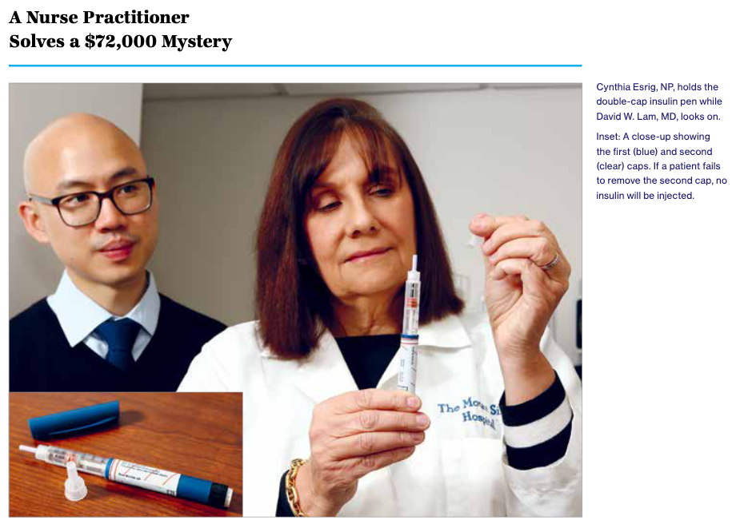
Troubleshooting Diabetes
Medication Adherence
Cost
Adverse effects
Appropriate education & training
Work/Life schedule
Diet
High glycemic index foods
Fruits
“Sugar free” foods
Meglitinides
TZDs
Higher Cost
GLP1-RA
SGLT2-i
DPP4-i
Sulfonylurea
Metformin
Lower Cost
Insulin

Slide 63
Conclusions
The care of a patient with diabetes is complex and multi-faceted – a challenge to do effectively in today’s health care environment
Utilize a systematic, evidence based approach in selecting medications based on the individual patient factors
Recognize cost and the burden of therapy when selecting medications
Enlist the help of allied professionals and specialists

Slide 64
Thank you! Questions? My Contact: David.W.Lam@mssm.edu

Slide 65
New! Condition Management Hub
Link: https://mshp.mountsinai.org/web/mshp/condition-management-hub
*Full condition pathways document may be downloaded

